Slide 1


7 WEEKS IN EINC
Neuromorphic Computing
Kalogirou Asterios – 28/04/2025

Slide 2
Contents
Beginning
Creating a dataset
Models
Looking forward
Conclusion
2 / 34

Slide 3
BEGINNING
3 / 34

Slide 4
First Four Weeks
The first 4 weeks were spent on learning as much of the basics as possbile before getting some hands on experience so I dont get overwhelmed.
A lot of reading into the team’s projects and papers was performed, as well as some of the team’s tutorials, which helped me to understand some of the modeling better and gave me a headstart regarding Neural Networks.
Of course nothing beats hands-on experience so in those four weeks I also got accomodated with the main library that I was going to be using, PyTorch.
4 / 34

Slide 5
First Four Weeks
Some PyTorch tutorials were completed explaining the API and also training some models from scratch with the MNIST dataset.
This specific tutorial made me build a ANN and two CNN models to classify the MNIST and the Fashion - MNIST datasets.
With this new found knowledge it was time to move forward !
5 / 34

Slide 6
CREATING A DATASET
6 / 34

Slide 7
Dataset (Simple)
After the first 2-3 weeks a project idea was being discussed and first task was officialy given.
Starting goal:
Create a dataset with some parameterization, so it is rather easy to classify. After some iterations of this dataset and some consulting with my supervisor (E.A.) a final function following the sin function was chosen.
7 / 34

Slide 8
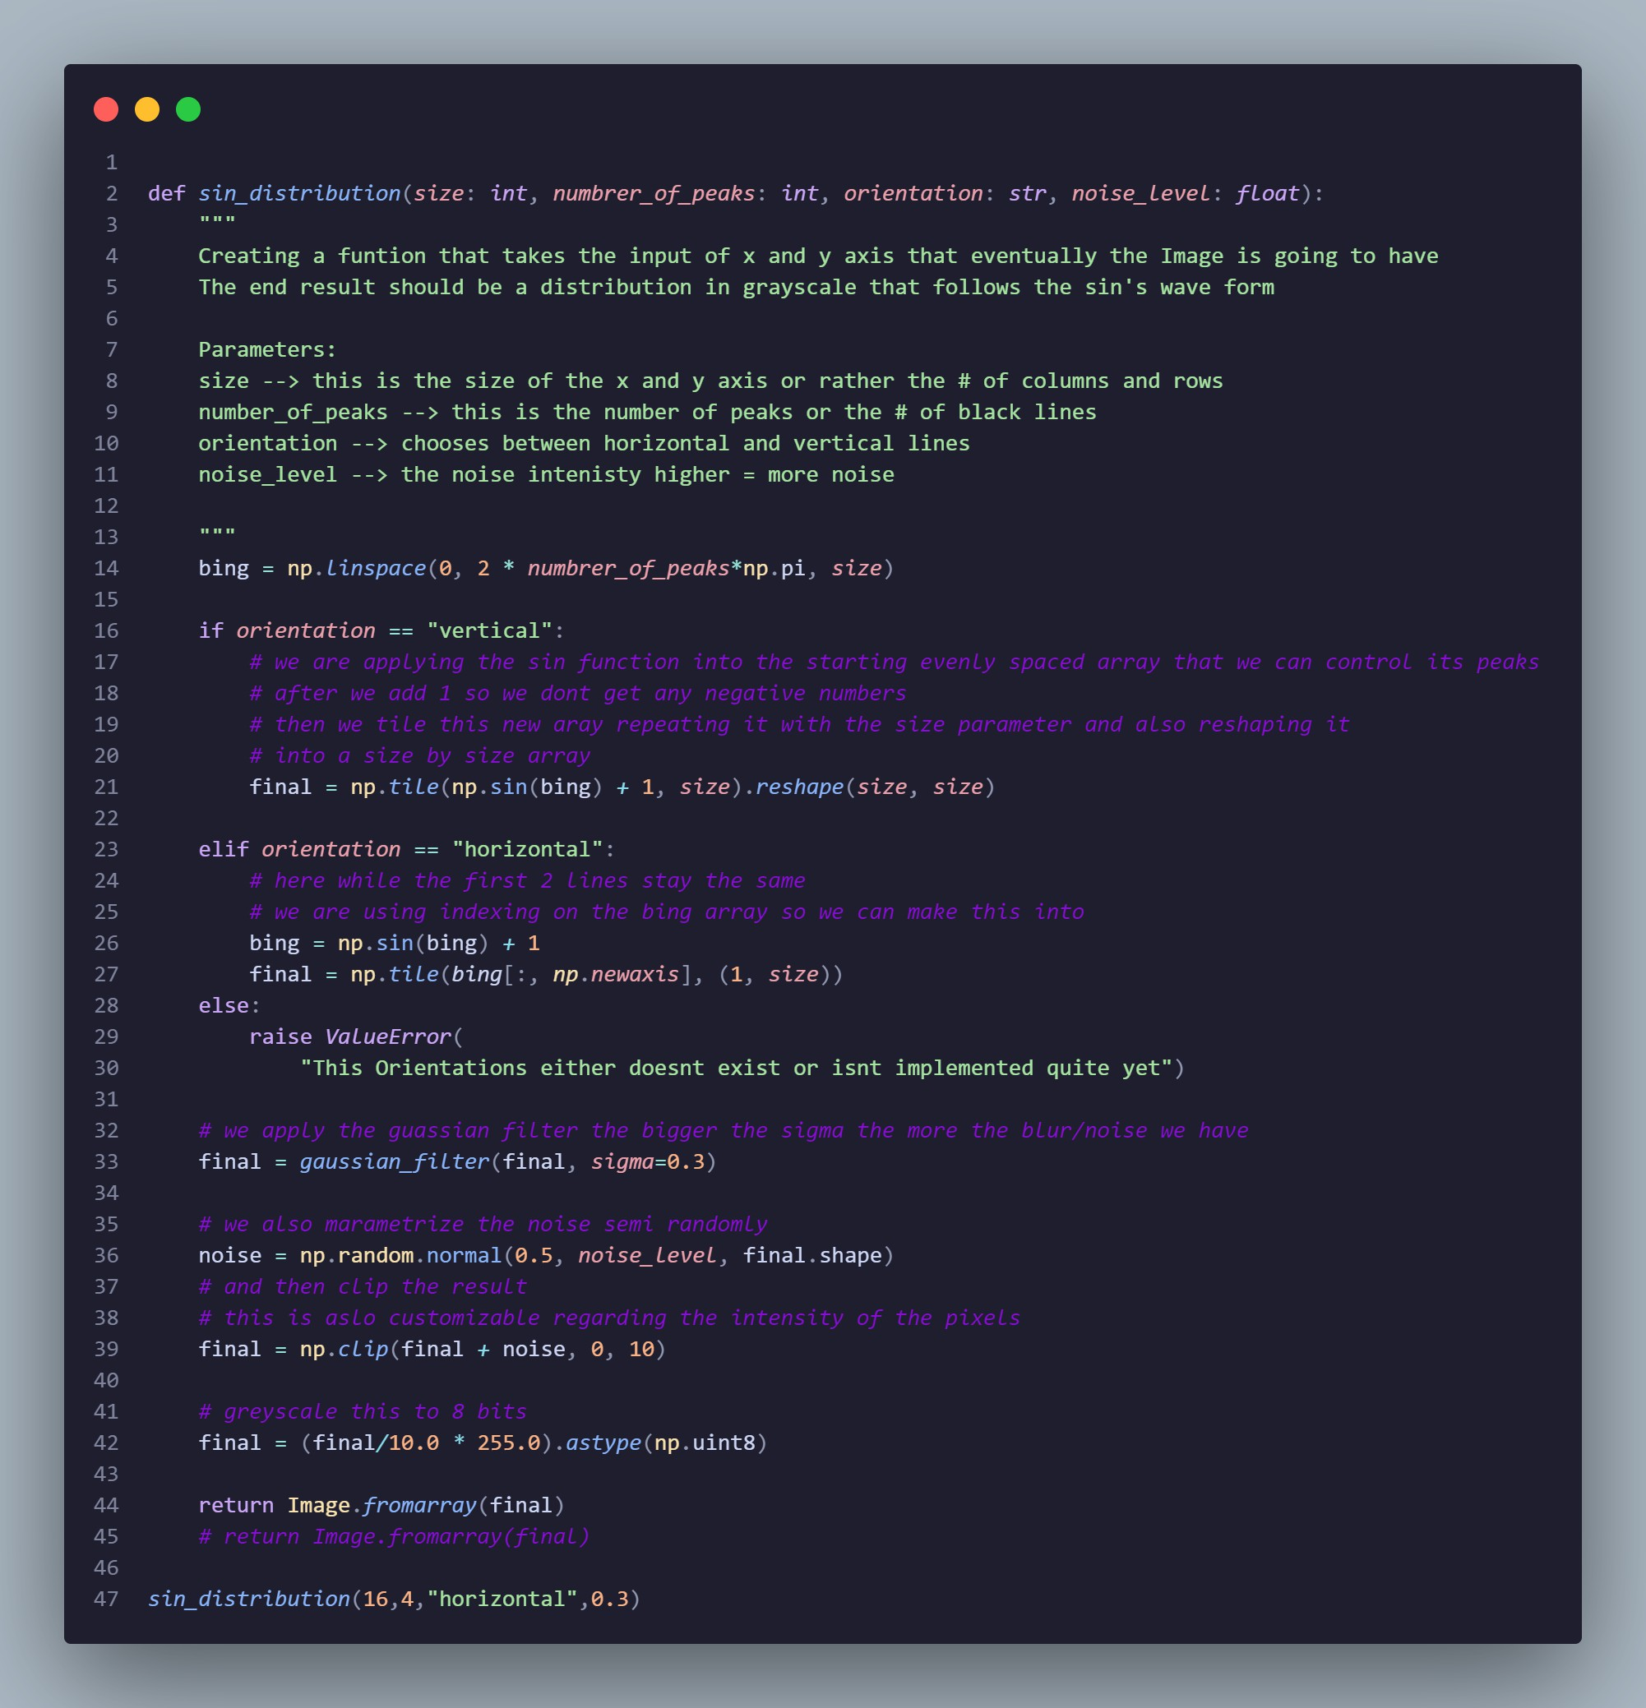
Results for the Custom Dataset
Yes this is the pixel accurate test image, the size limitations were discussed with Elias and Eric (mostly between them) so it can later be implemented easier on hardware.
Figure 2: Pixel Accurate Image Result
Figure 1: Code for the main dataset function
8 / 34

Slide 9
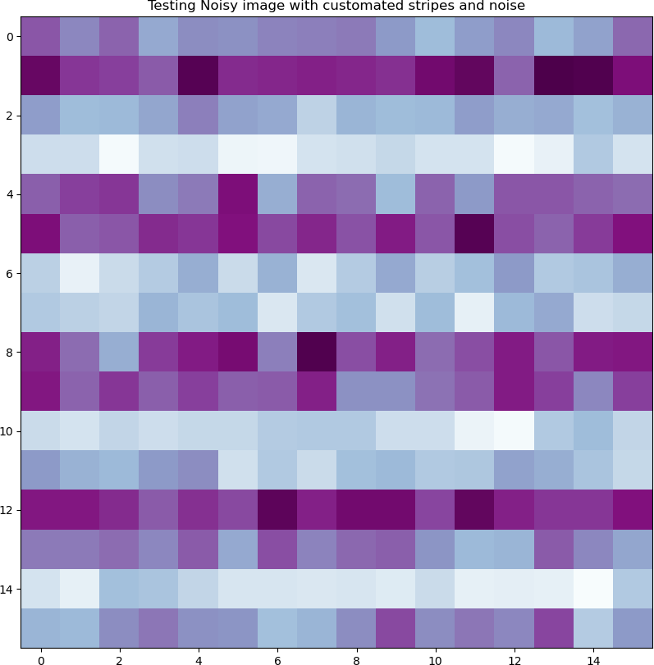
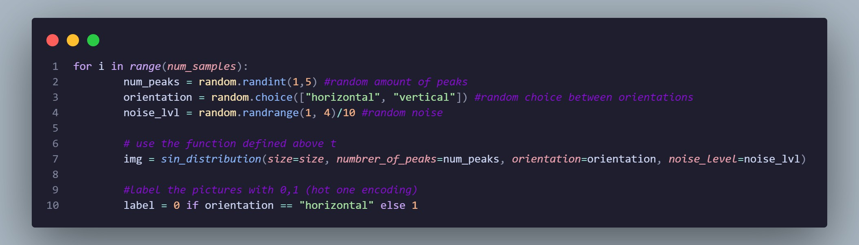
Results for the Custom Dataset
This is the plotted image that was randomly generated before.
A second python script was created to generate a num_samples images with randomized orientation, stripes and noise. Here is the part of that code that customizes that:
Figure 3: Scaled up plotted test Image
9 / 34

Slide 10
Dataset (notes)
The customizable features have a certain limitations that makes sense both spatial-wise (e.g. the stripes cant be more that half the image size) and logically-wise (e.g. after a certain noise threshold the images become smooth)
Here the labels are encoded to 0 and 1 for horizontal and vertical lines respectively, also the images are saved in such a way : image.index_encoded.label.png .
Meaning we can extract the label directly from the loaded image without the need of
a .csv file.

Slide 11
Dataset initialization
By importing the Dataset class from the module torch.utils.data we can create a custom class that inherits from the Dataset class of PyTorch, so we can create it to our liking.
The vital methods are the transform and the root which enable the dataset to be tracked
(located) and also transformed (from png files to Tensors for PyTorch usage)

Slide 12
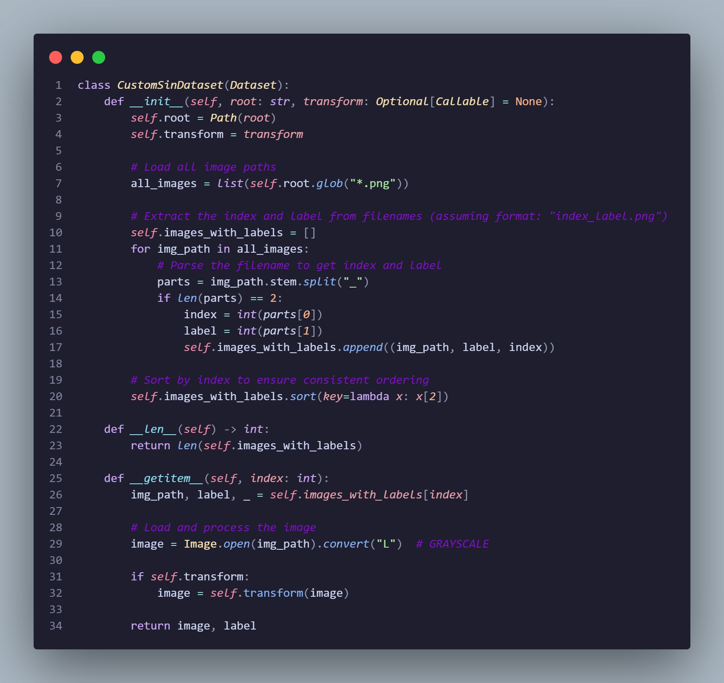
Figure 5: Import of Dataset
Figure 6: Custom class Dataset

Slide 13
MODELS

Slide 14
Models
Many models were created until a desired model was finalized, the procedure that was recommended by my supervisor was to start broad with the limitations and slowly to start adding new important features.
This method was very effective regarding the learning and the results.
1. The first model was a simple SNN model that was tested using a version of the custom dataset that required a .csv file. While the model did learn to differentiate vertical and horizontal lines, 30 epochs were neaded and it never fully converged for this simple task (reaching about 90% accuracy).

Slide 15
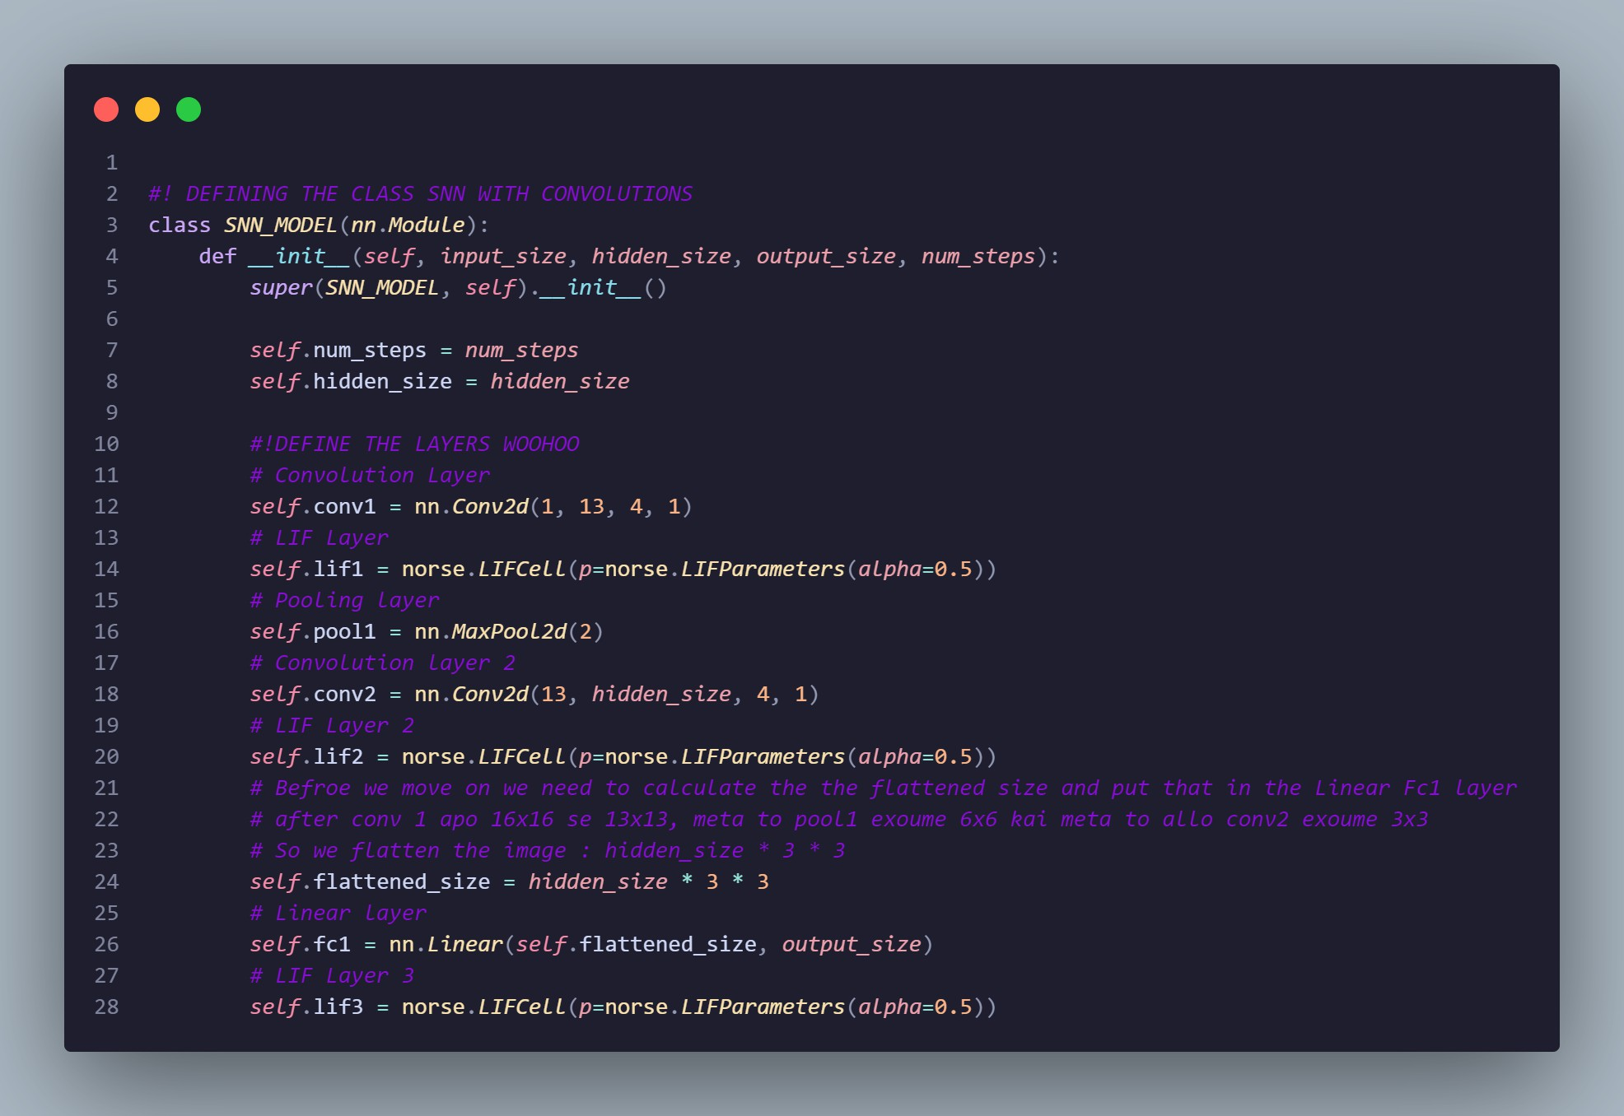
Models
2. In the second model we took the existing SNN model that was working and also added a convolution layer mainly using the norse library.
Figure 7: 1st SCNN model

Slide 16
Models
This is a very inefficient model with many layers that are very unneccesary, to be exact, the model consists of two convolution layers, a pooling layer, 3 LIF layers and a fully connected (linear) layer.
The convergance happens extremely fast at aroun epoch 3 which means we can simplify this model quite a lot !
Since it works though, the next step was to add some kind of encoding or rather add the temporal dimension.

Slide 17
Models
3. The third model’s goal was to add the time dimension to the mix.
The results here were much harder to “make sense” because the model was now much simpler and a little harder for me to train since we added the time dimension.
This was done by using a specific import :
from norse.torch.functional.encode import poisson_encode
Not a lot of time was spend optimizing this model because the encoding we were striving
for was a And the new simpler and time encoded
constant current over time method.
model looks something like this :

Slide 18
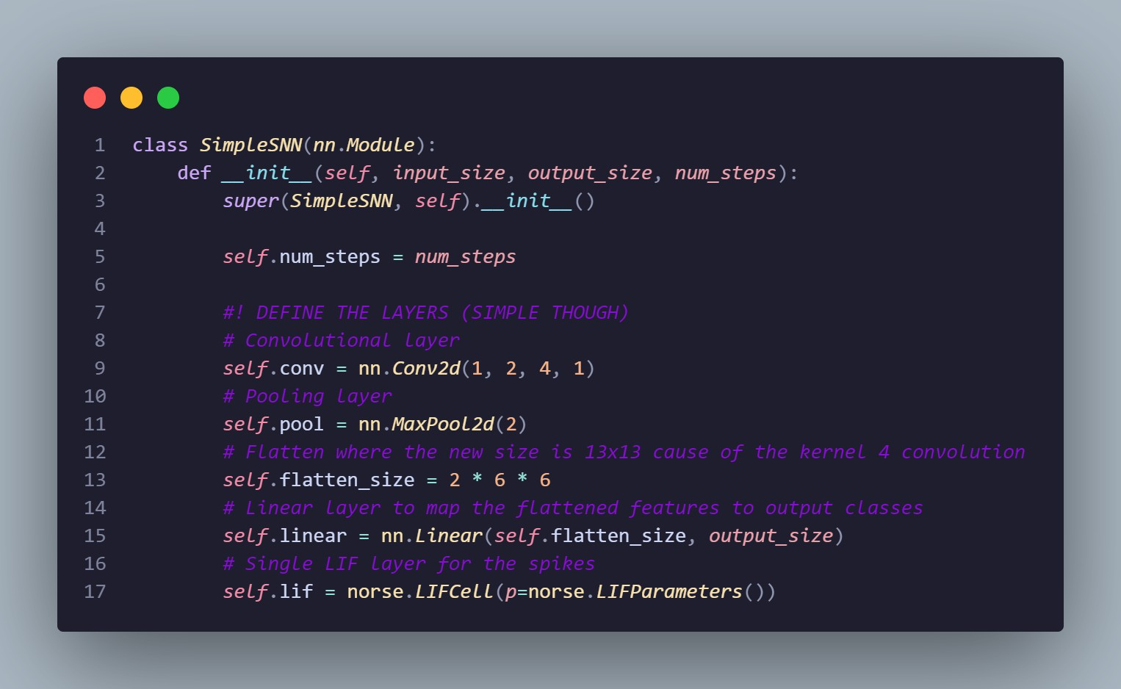
Models
So here the inputs get encoded using the poisson_encode function that was imported changing the shape of the tensors to [Time, Batch_Size,Channel, Height, Width]
Figure 8: SCNN + TIME

Slide 19
Models
4. Fourth model is almost identical to the previous one with the only difference being the encoding.
from norse.torch.functional.encode import constant_current_lif_encode
In order to rate this model, the class was decided with highest spike count per sample.
highest spike count per sample
in the output layer.
Here an accuracy of ∼98 % was achieved which is almost ideal.
Here are some results taking random inputs to see if the model has a weakness to any specific pattern:

Slide 20
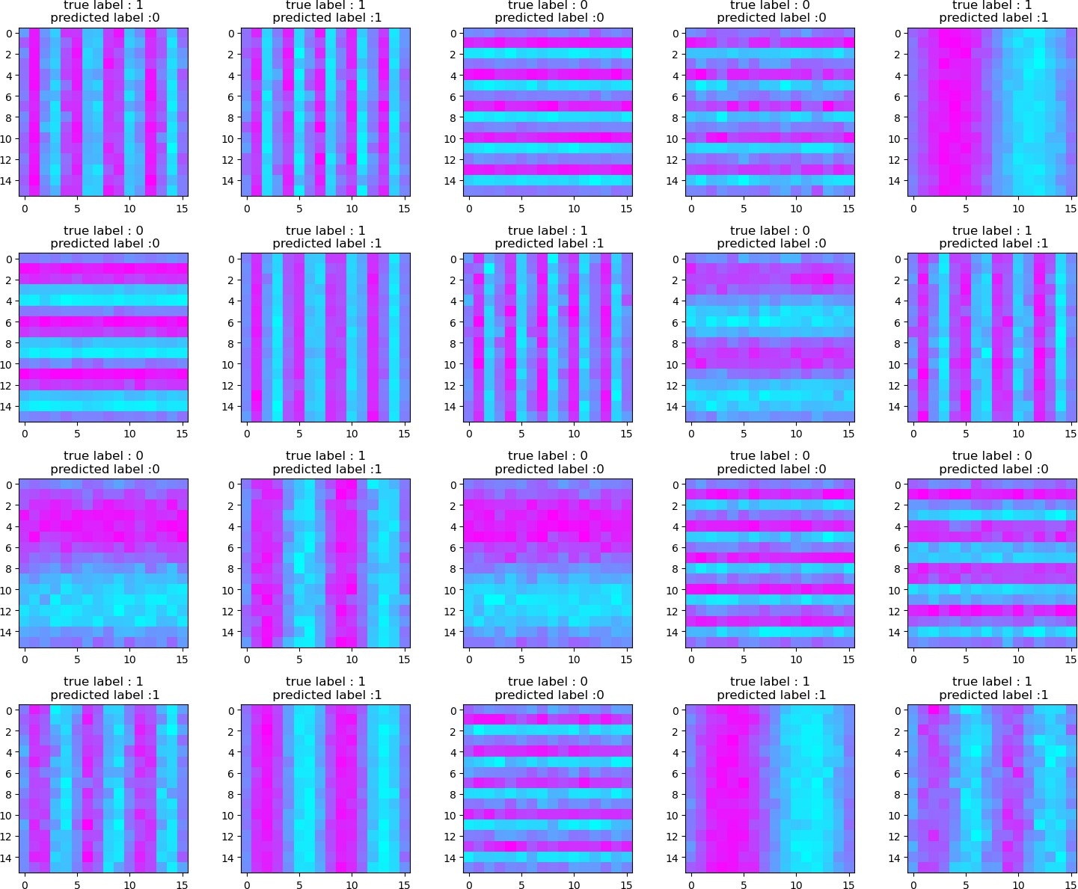
Models
Here we can see that the model struggles with a great number of stripes while also having high level of noise.
Still this is a very good result but we can make the model even better by changing the architecture and adding a LI layer.
Figure 9: Random Images in the Trained Model

Slide 21
Models
5. The fifth model is the final model that I have made completely from scratch (so not counting any tutorials) and its the best one to date.
The code for the model looks something like this :

Slide 22
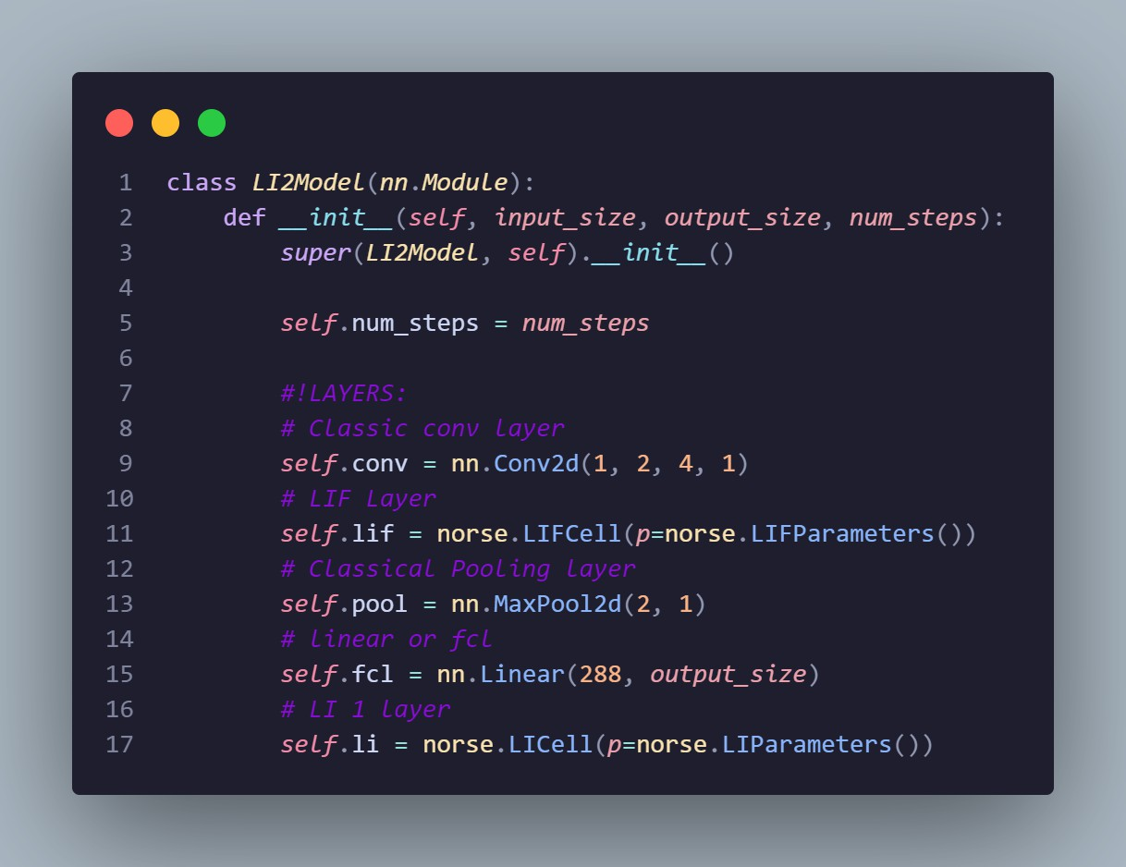
Models
The network architecture includes a
rate encoded input,
a convolutional layer with 2 filters size 4x4 ,
a LIF layer for the spikes ,
a max pooling layer which reduces the spatial dimensionality ,
a flatten + linear layer and finally
a LI layer which models membrance voltage traces with decay, in order to capture long-term temporal information.
Figure 10: Code block for the final model

Slide 23
Models
This model is both simple enough to move into hardware and also gets perfect results regarding the taks it is given.
The network fully converges at around epoch 9 meaning we get ∼ 100% accuracy on our custom dataset and since is the best model so far some extra plots were made using a custom python function.

Slide 24

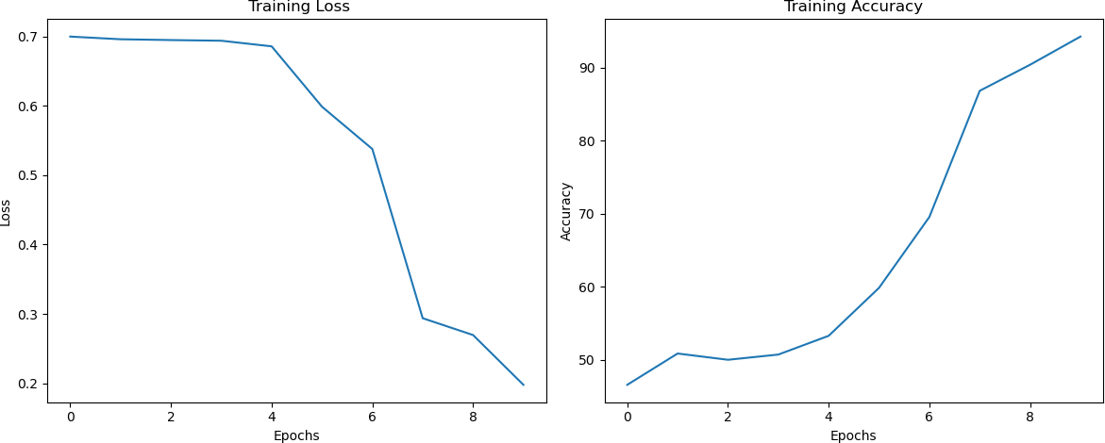
Results of Final Model

Slide 25
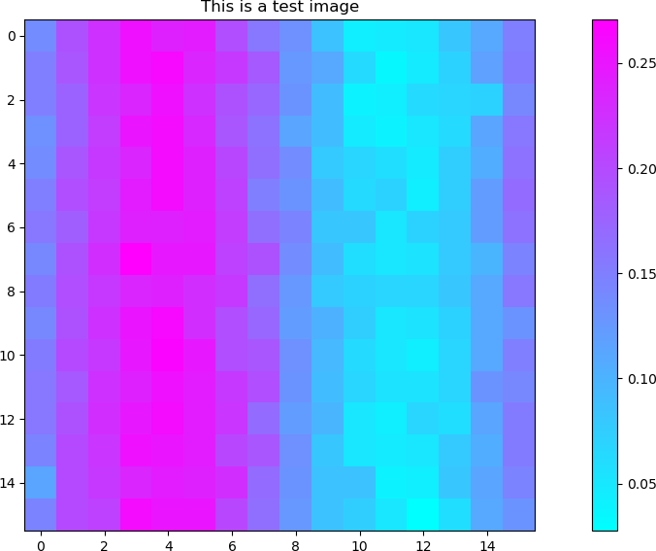
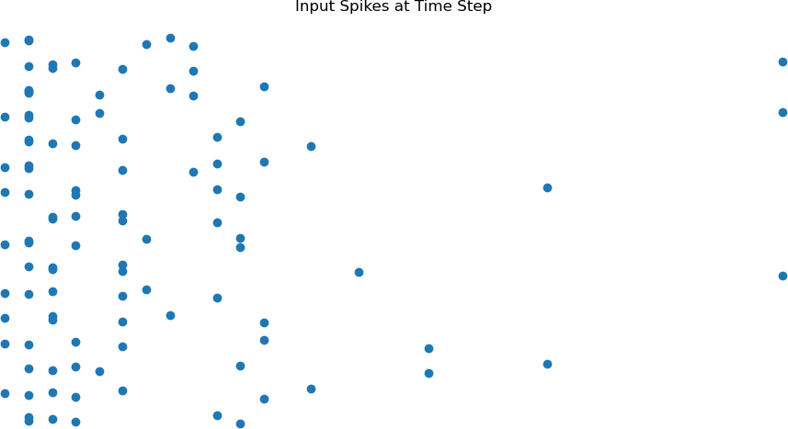
Results of Final Model
Figure 13: Input Spikes of the Test Image
Figure 12: Test Image

Slide 26
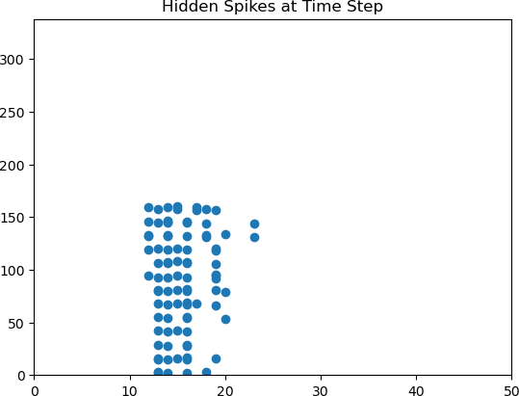
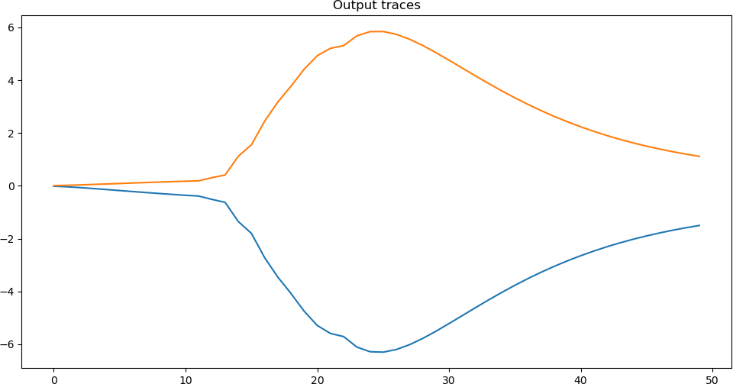
Results of Final Model
Figure 15: Membrance Voltage Traces of the two Output Neurons over Time
Figure 14: Hidden spikes over Time

Slide 27
Comments
Here we can see that the output neurons are symmetric over the 𝑦 = 0 line meaning that classification is possible with only one output neuron.
Having achieved our starting goal, an idea to change the dataset and make it a little harder was suggested.
And so this exact model, with minor changes to the scaled encoded input values, was tested on a dataset that has the same parameterization as the previous one with the difference that now striped patches are randomly placed around a noisy grid.

Slide 28
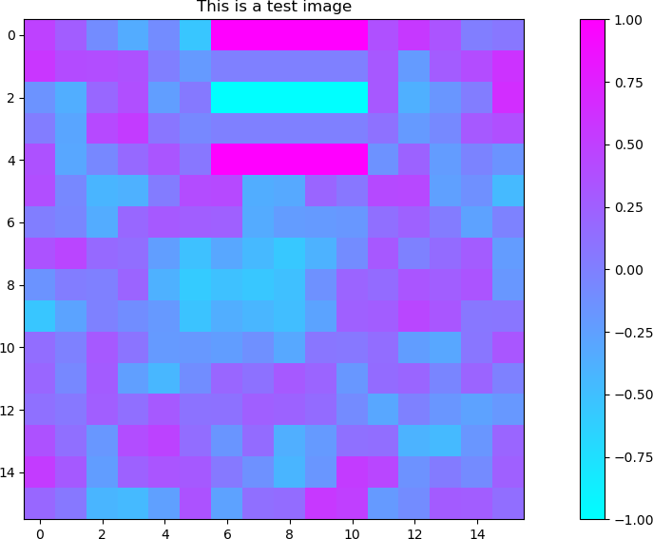
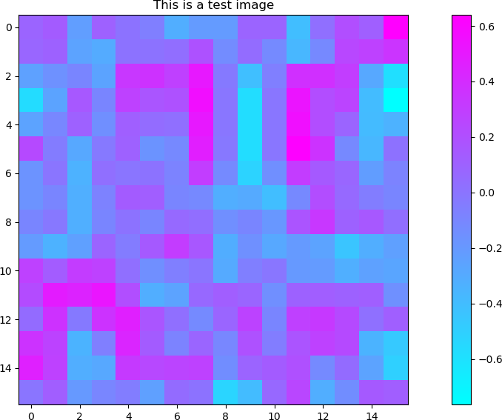
Comments
The dataset with the easier pictures got a training for ∼ 18 epochs and it fully converged at around 12 epochs
While the dataset with the harder images is learning, more epochs are recquired and more changes on the model to make this model converge fully.
Figure 16: Test image with an easier version
Figure 17: Test image with a harder version

Slide 29
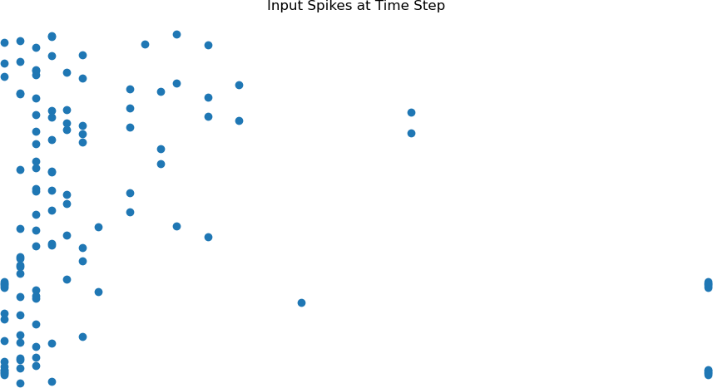
Comments
Figure 19: Input spikes over time
Figure 18: Test image of the easier version

Slide 30
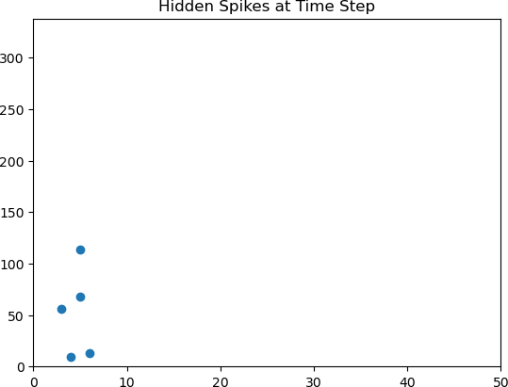
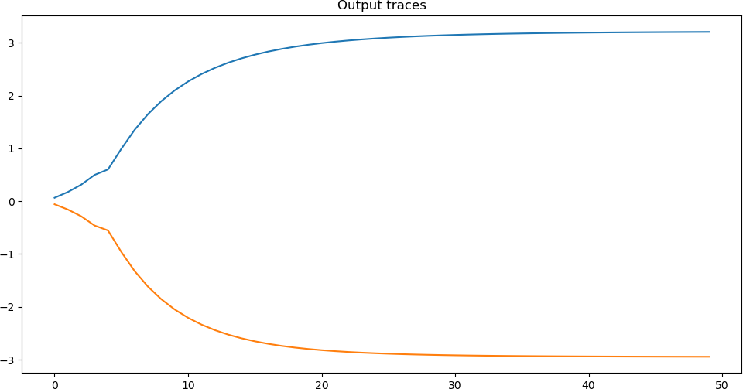
Comments
Figure 21: Membrance Voltage traces in the 2 neurons
Figure 20: Hidden Spikes

Slide 31
LOOKING FORWARD

Slide 32
Next Steps
As of now the next direct step is going to be transfering this model and the (easier) dataset to hardware and to try and make it work there.(it has already begun)
Also since the membrance voltage trace of the output neurons are symmetric the second
existing output neuron could be changed, along with the way that the image is encoded through time to classify the rotation of it (clockwise - counterclockwise).
Finally some other ideas might pop up which are always fun to talk about and
implement.

Slide 33
CONCLUSION

Slide 34
Conclusion
Over the course of these 7 weeks, I’ve had the opportunity to immerse myself deeply into the field of programming and neuromorphic computing . I have gained a solid foundation in PyTorch, built and trained spiking neural network models, and developed custom datasets—all of which helped me better understand both the theory and practical application of neural-inspired computation.
Looking ahead, I’m enthusiastic about continuing this work—particularly as we begin transitioning models to hardware—and I’m eager to keep learning, improving, and contributing to the team’s goals.

